Slide 1
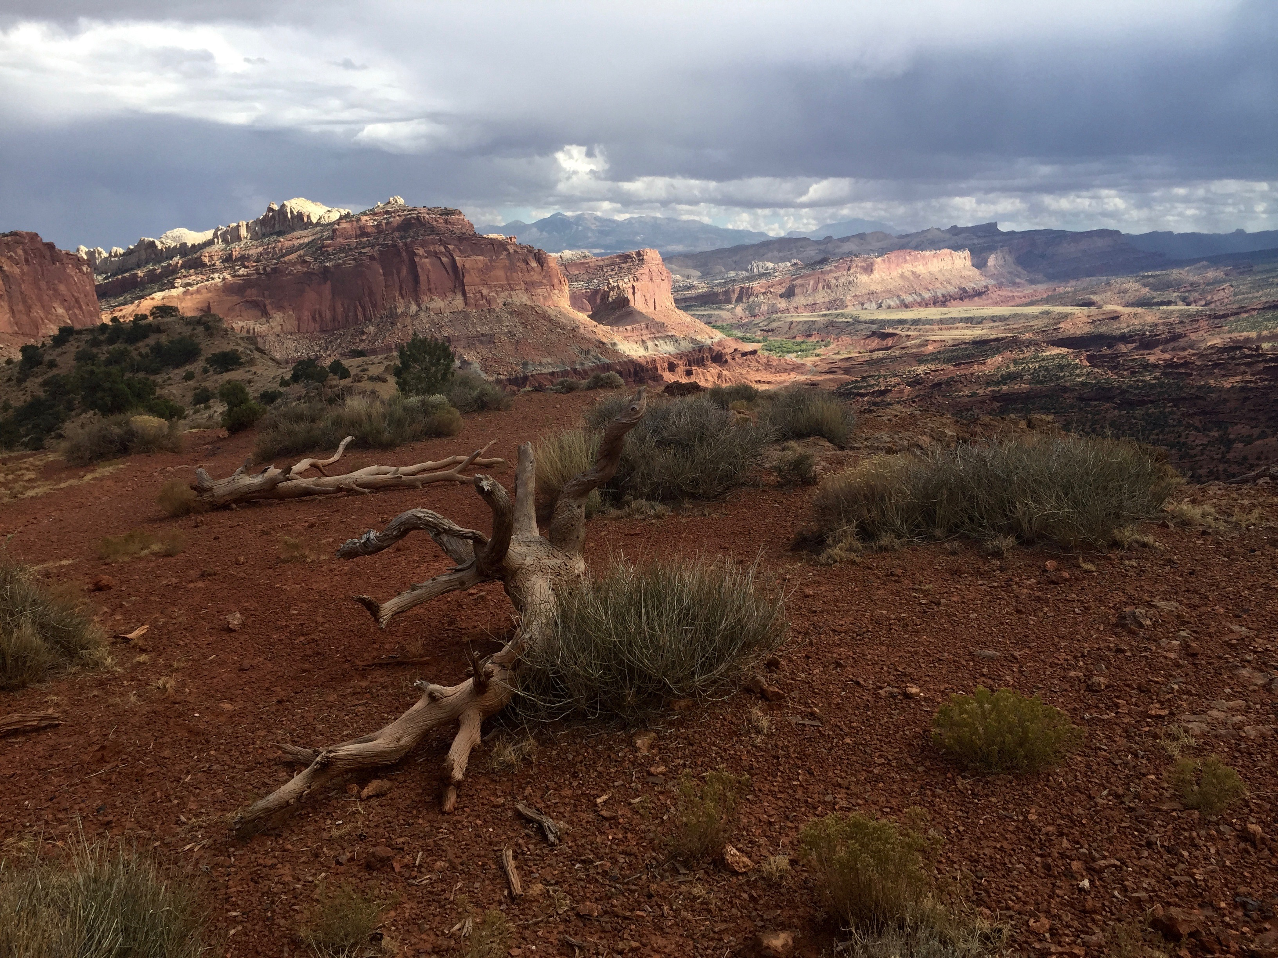
2nd International Summit on Human Genome Editing
Hong Kong
November 27, 2018
Dana Carroll
Department of Biochemistry
University of Utah School of Medicine

Slide 2
Asilomar, 1975
First Summit on Human Gene Editing, 2015

Slide 3
What CRISPR does – genome editing
Gene KO
CRISPR
Cell activities
Gene correction

Slide 4
Human embryo injection
Dr. Kathy Niakan, Nature
Published in Science 09.20.2017

Slide 5
CRISPR’s unintended consequences
Gene KO
CRISPR
Cell activities
Gene correction
Off-target mutations

Slide 6
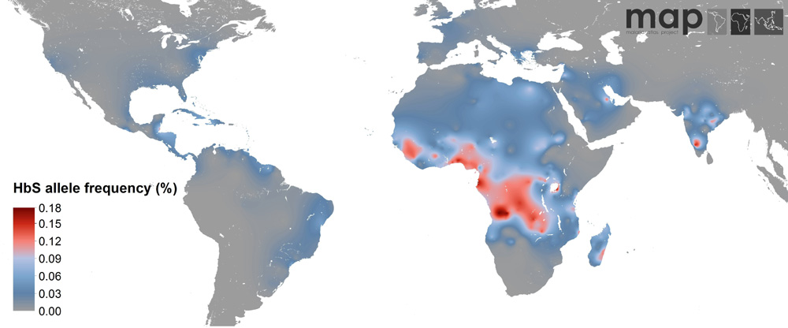
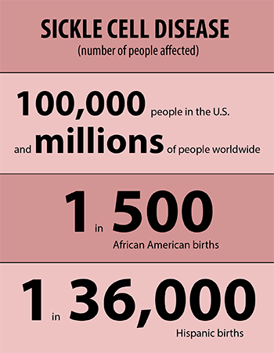
Distribution of the sickle allele
University of Oxford
US FDA

